Slide 1
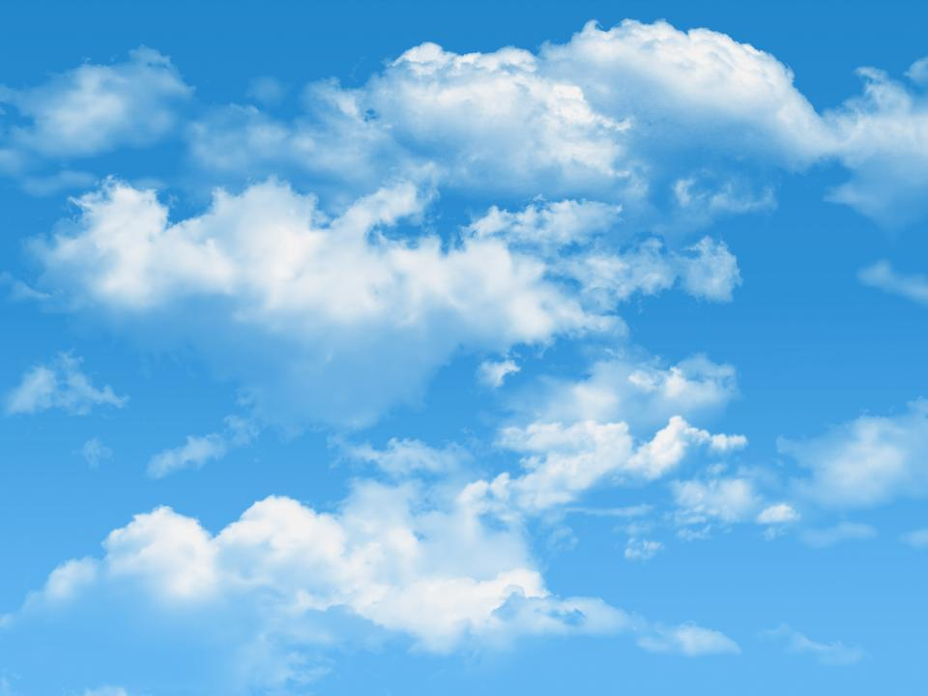
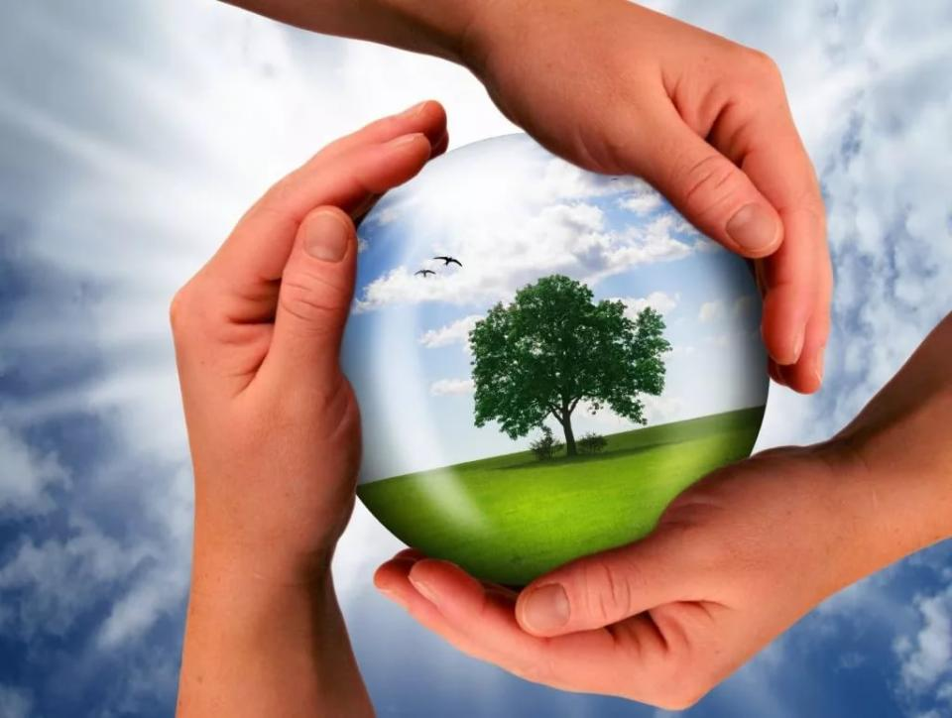
Who should be in charge
of the planet?
УМК “English 7”, В.П. Кузовлев
Терехова Лариса Николаевна
учитель английского языка высшей категории
МБОУ СОШ с. Стегаловка, Долгоруковский район, Липецкая область

Slide 2
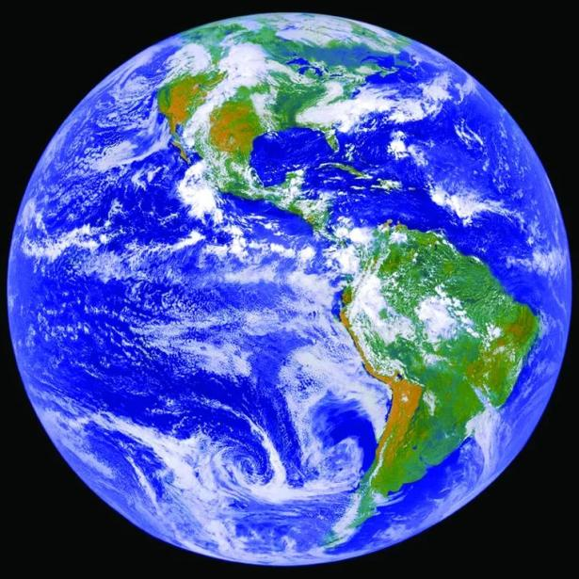
The Earth is our home, isn’t it?

Slide 3
We have the blue sky

Slide 4
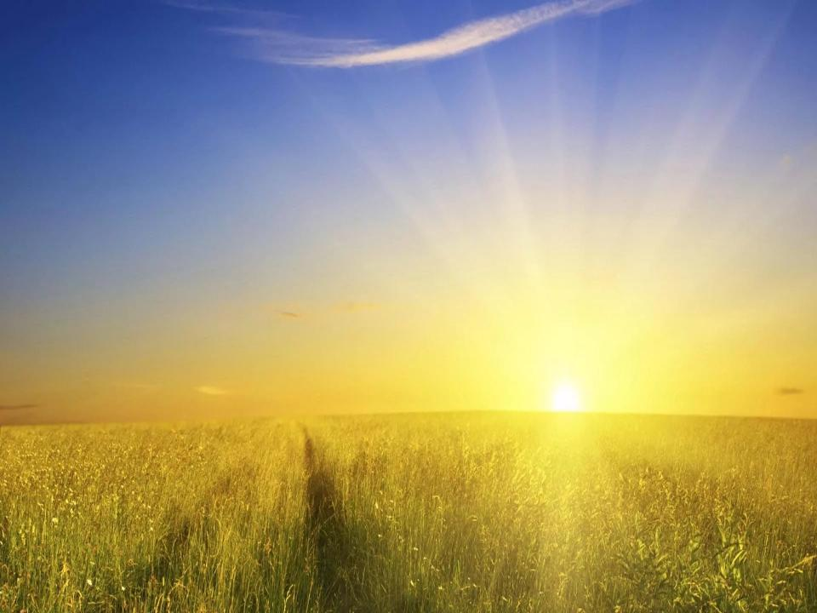
and the beautiful sun.

Slide 5
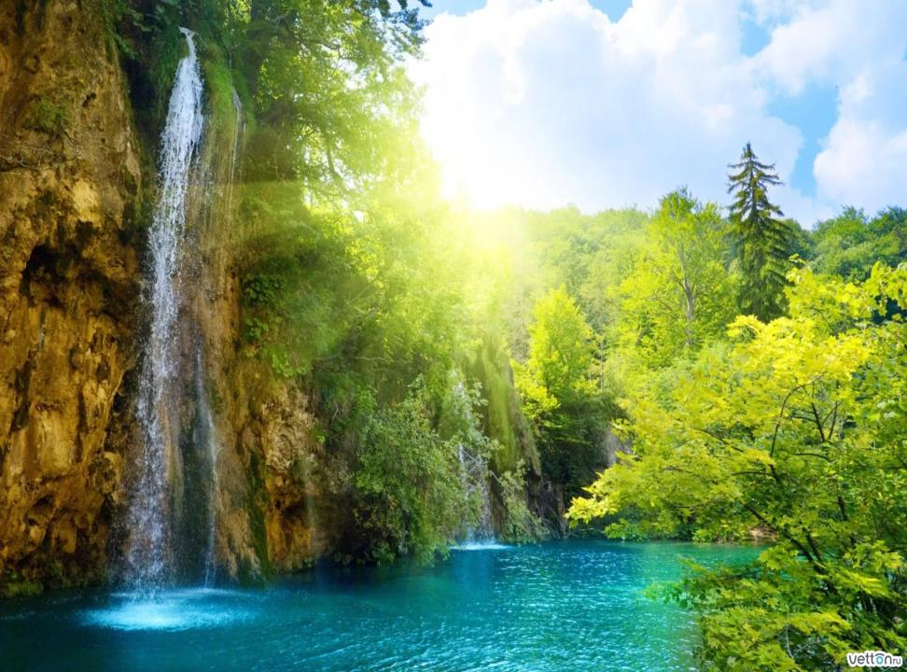
Look at our beautiful nature!

Slide 6
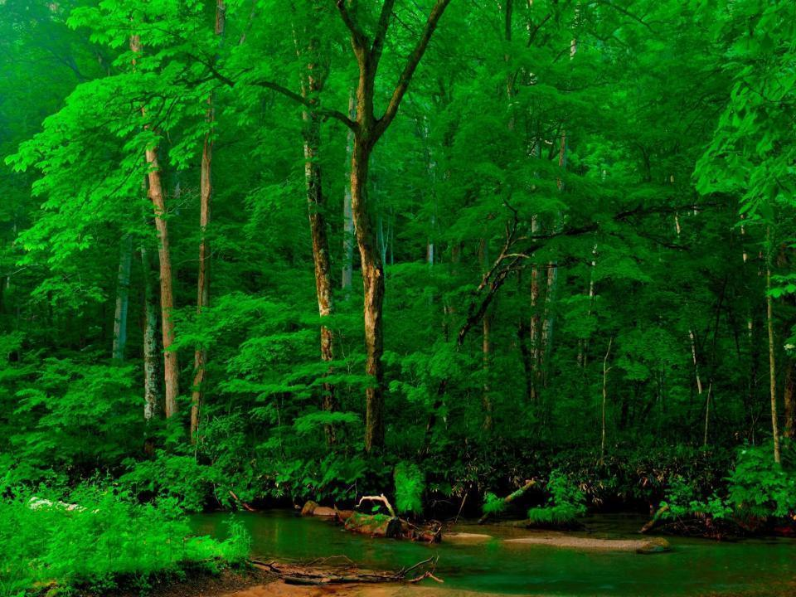
We have a lot of green forests,

Slide 7
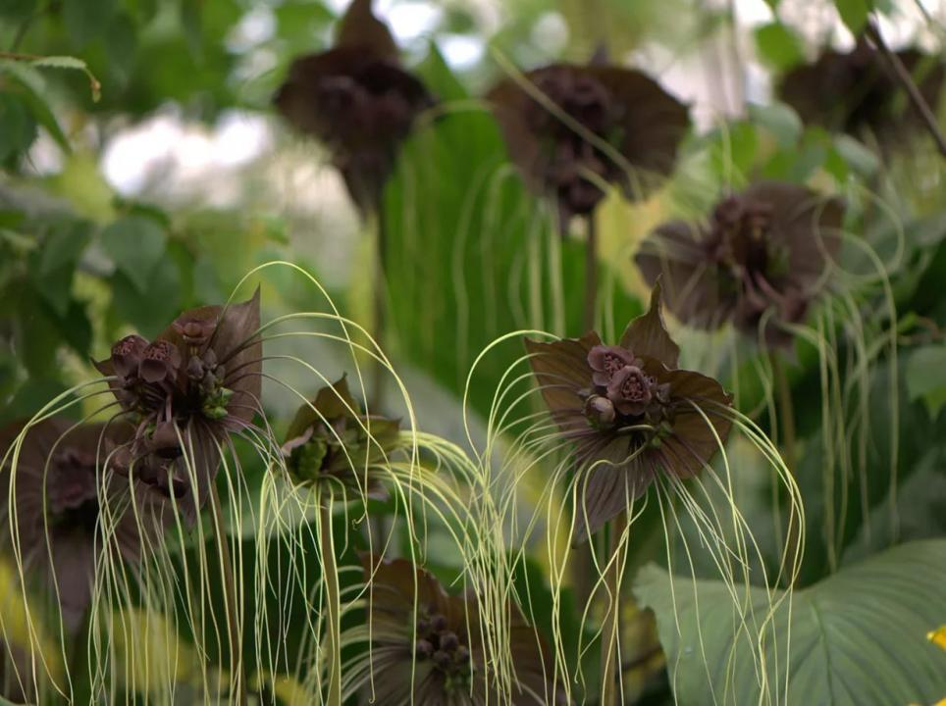
amazing plants,

Slide 8
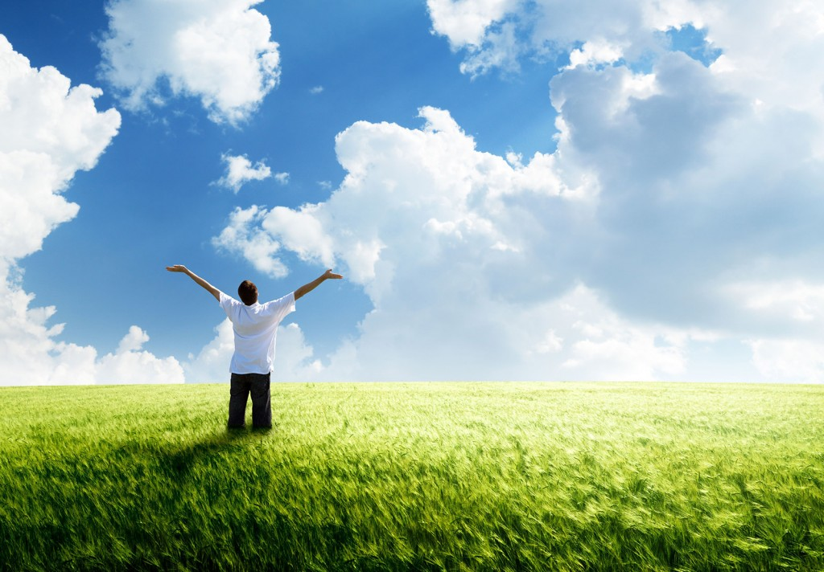
clean air,

Slide 9
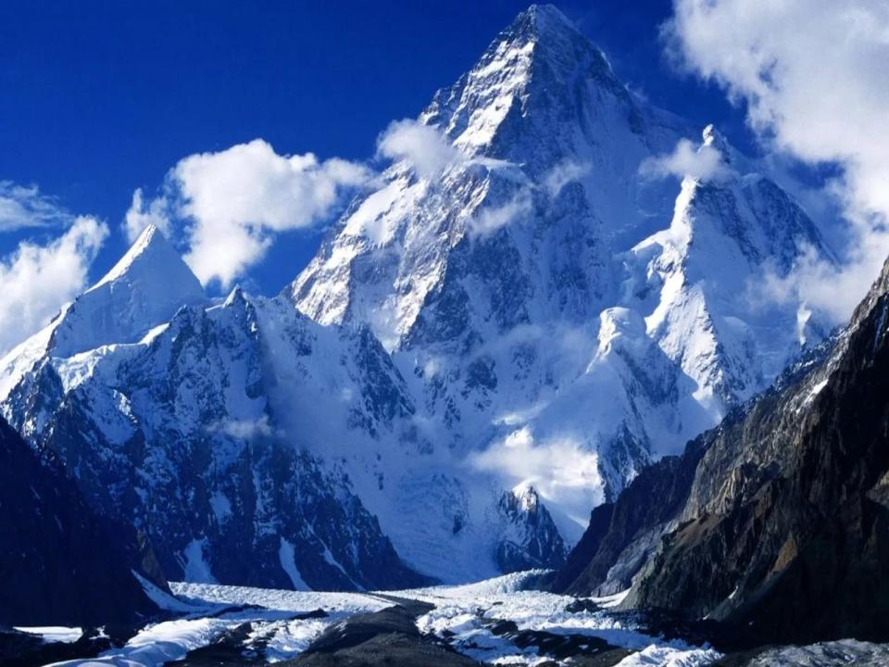
high mountains,

Slide 10
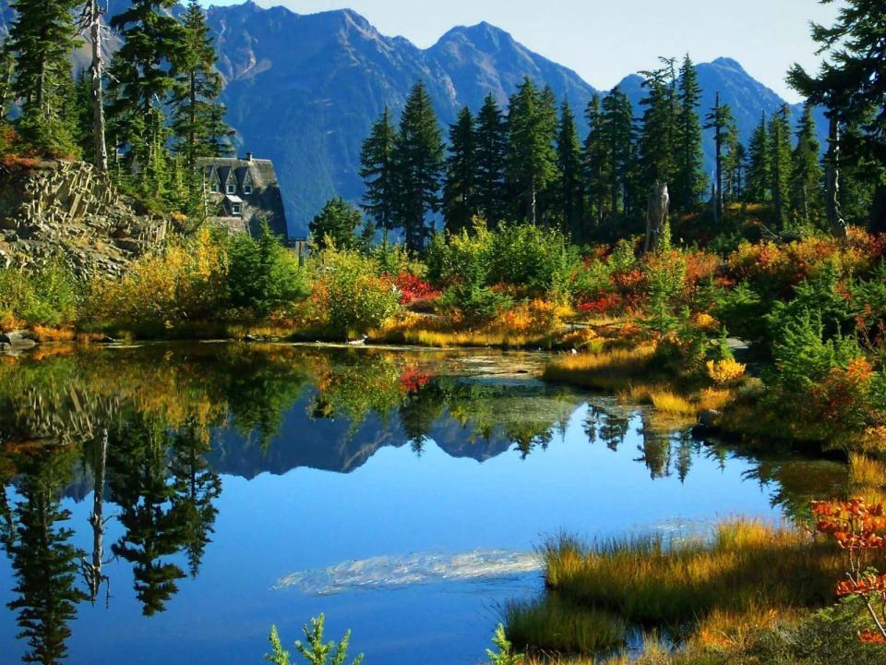
many beautiful lakes,

Slide 11
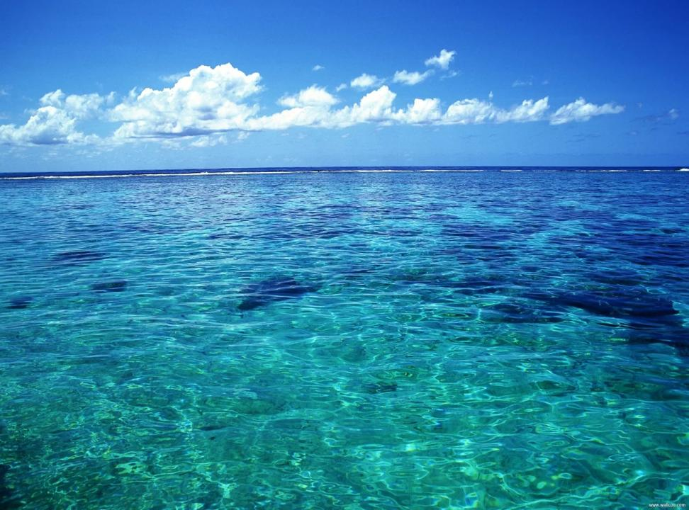
big oceans,

Slide 12
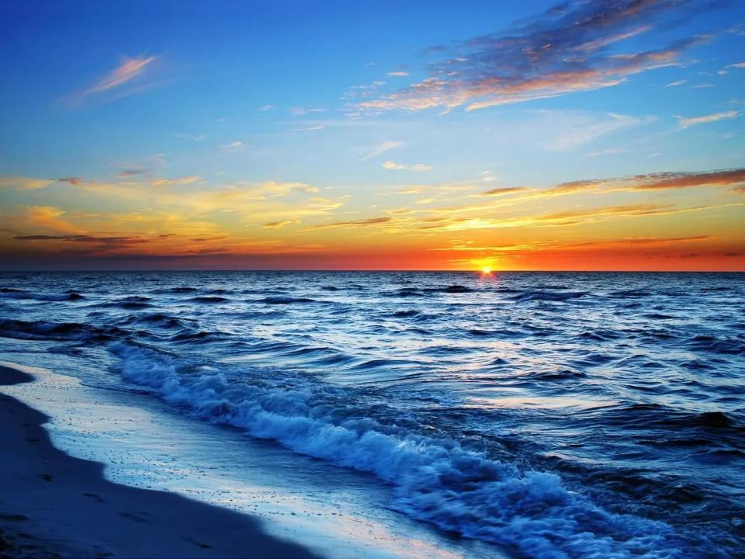
a lot of deep seas,

Slide 13
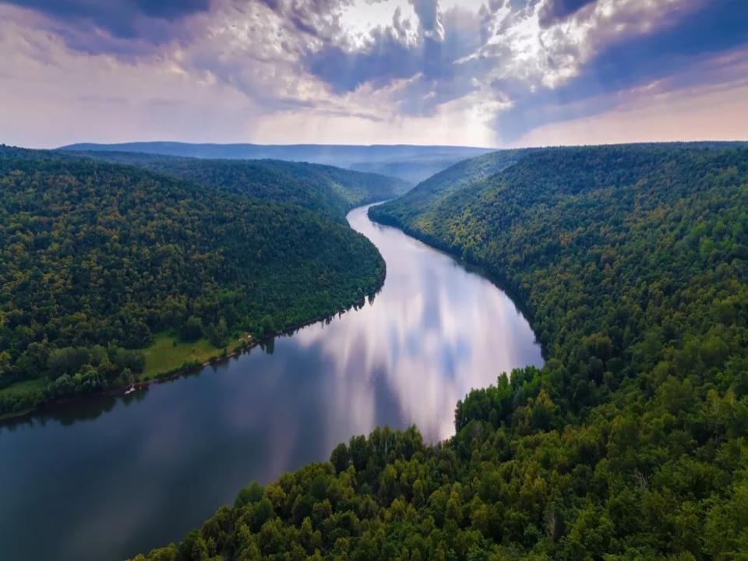
long rivers,

Slide 14
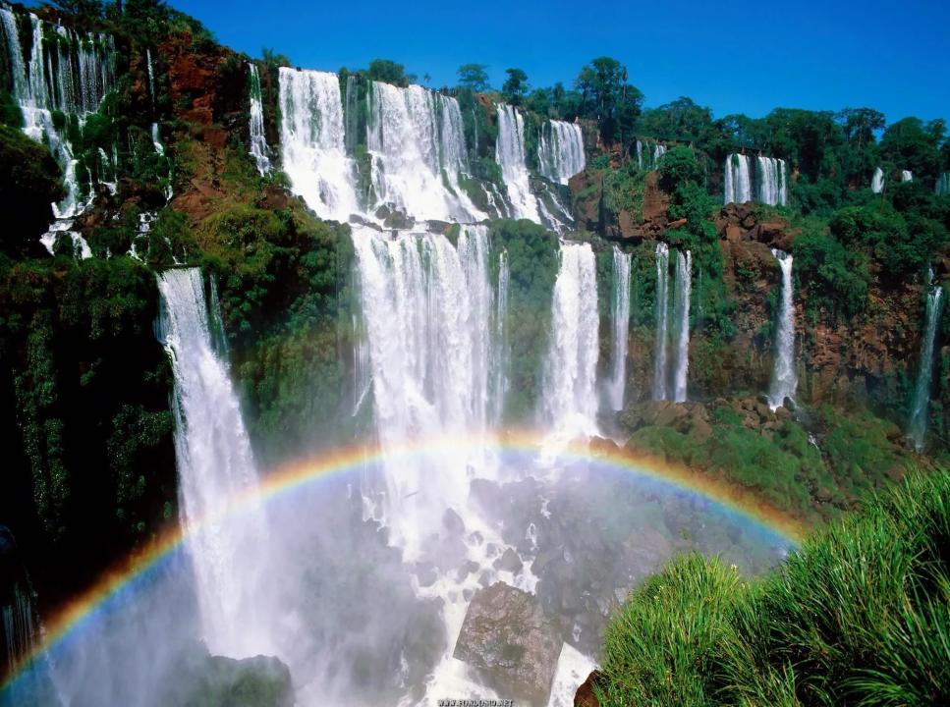
great and beautiful waterfalls,

Slide 15
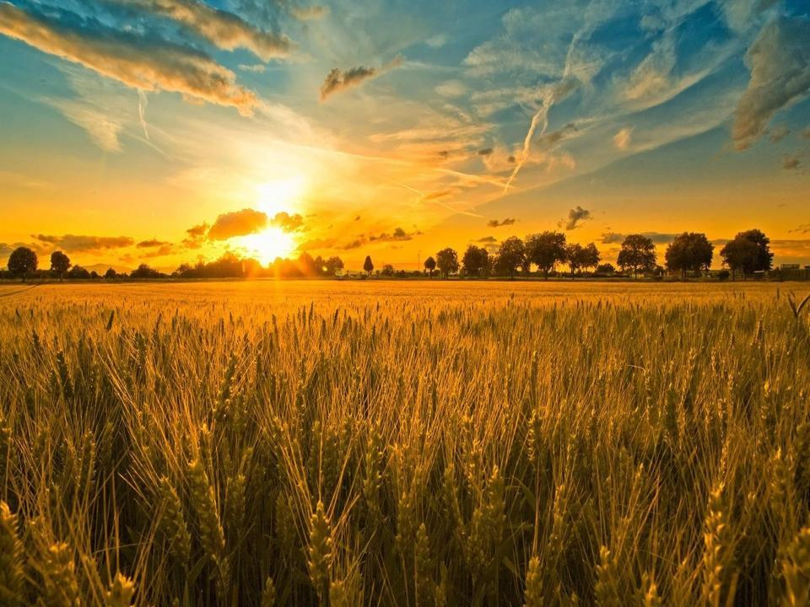
many wonderful fields with different flowers.

Slide 16
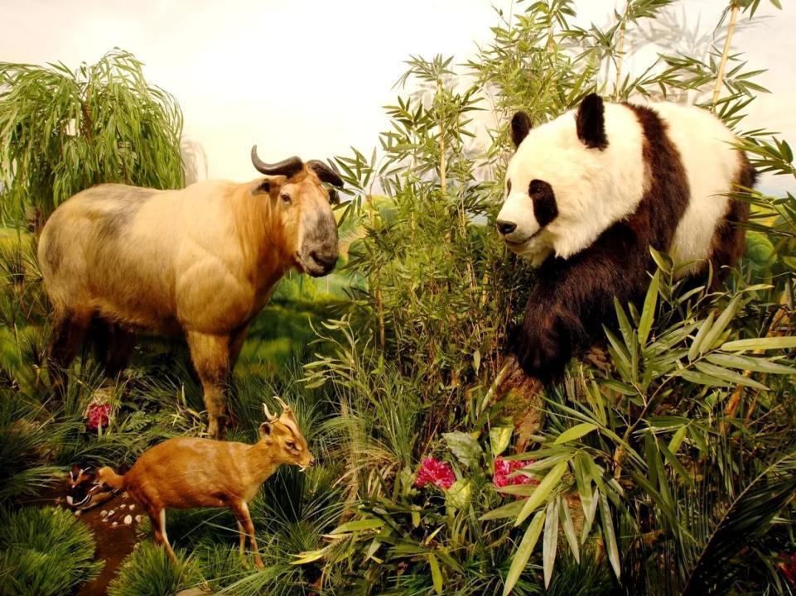
Our world’s fauna is extremely rich.

Slide 17
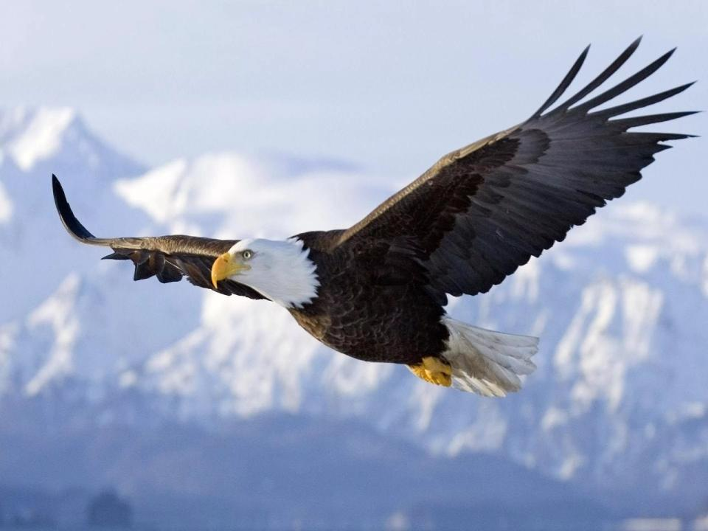
We have a lot of various species of birds

Slide 18
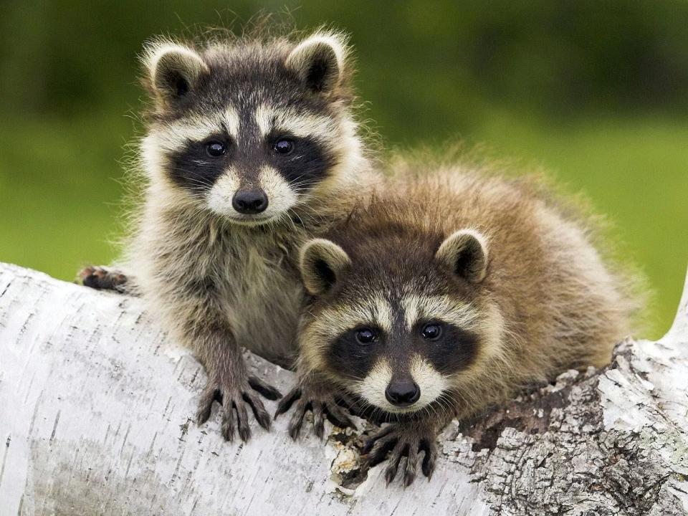
and animals.

Slide 19
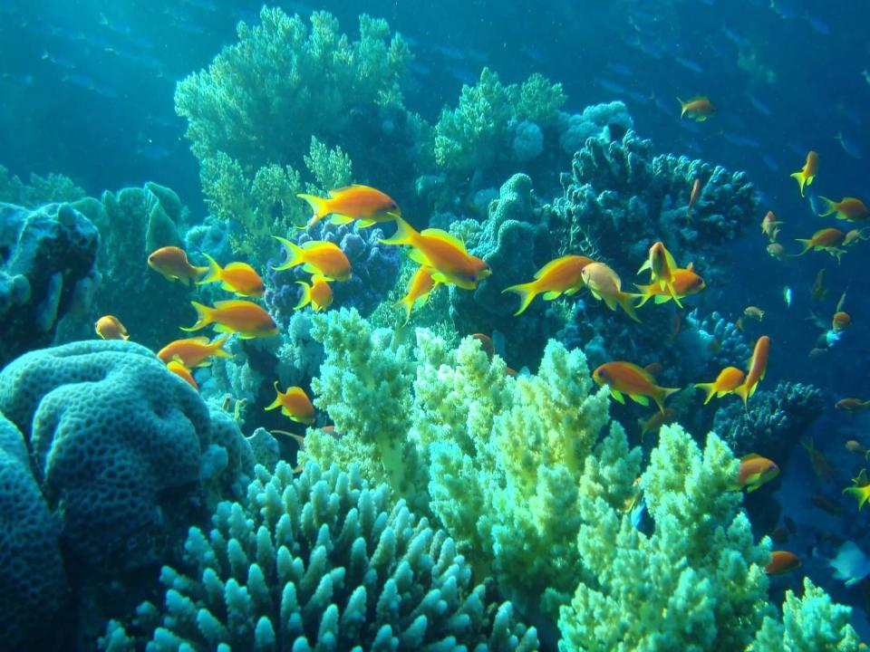
Admire our wonderful underwater world!

Slide 20
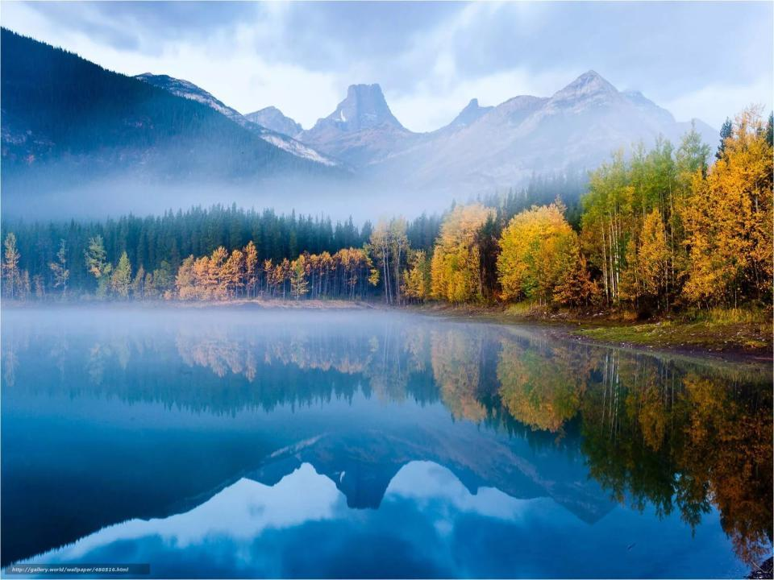
Since ancient times Nature has served Man, being the source of his life.

Slide 21
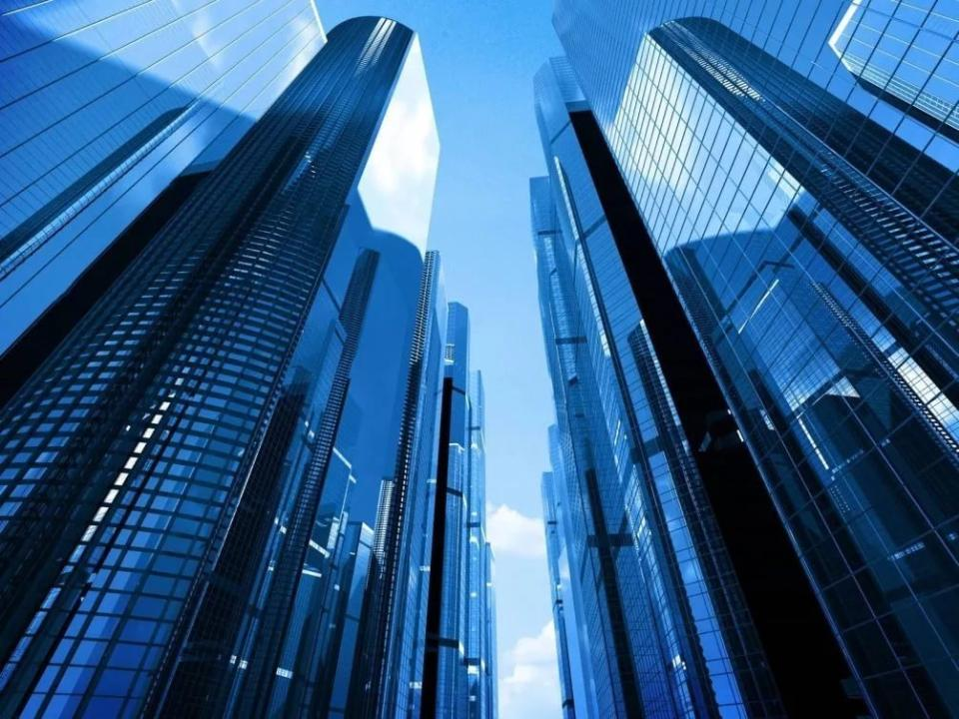
What’s happening now?

Slide 22
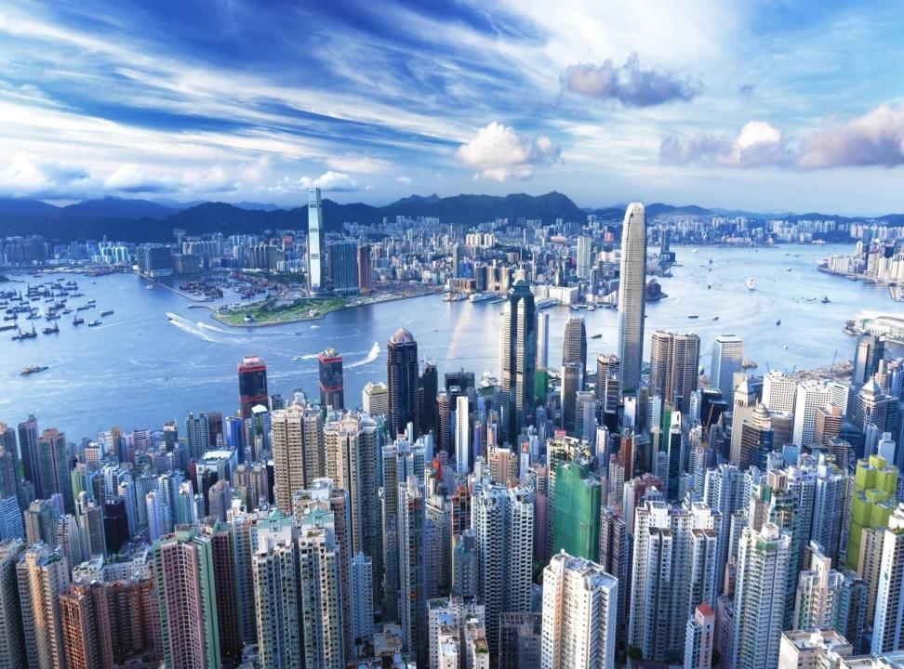
We have many cities and towns.

Slide 23
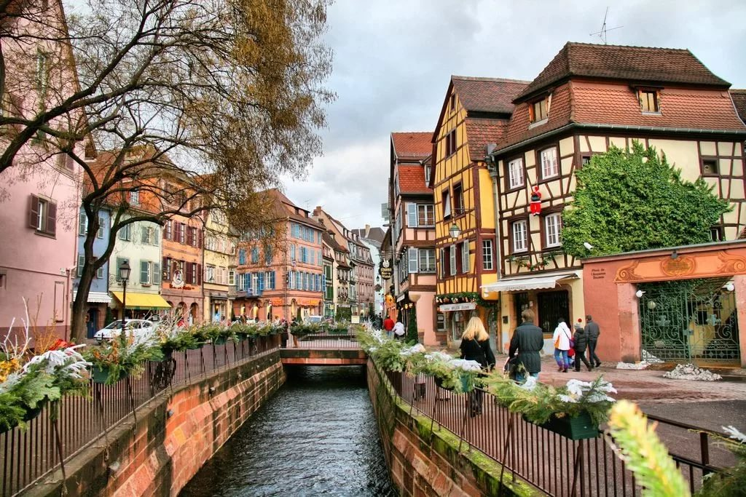
Our population is growing very quickly.

Slide 24
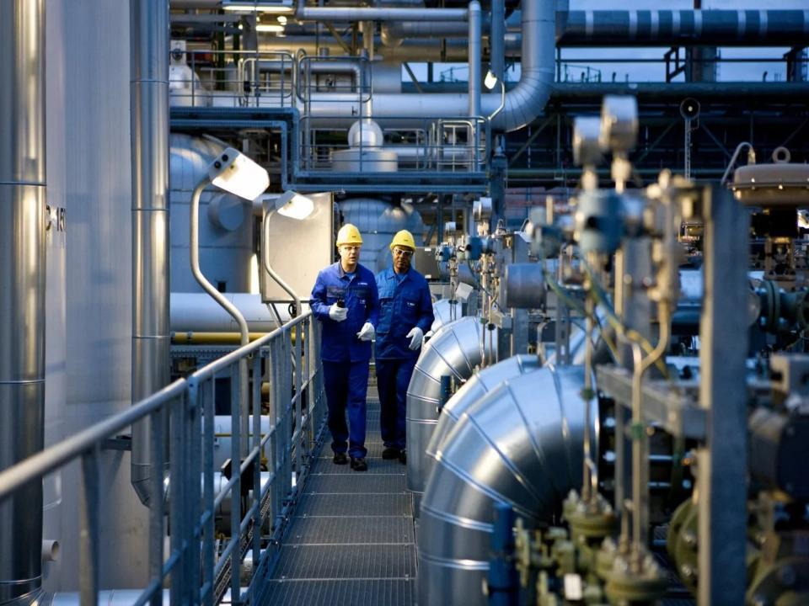
We develop different industries,

Slide 25
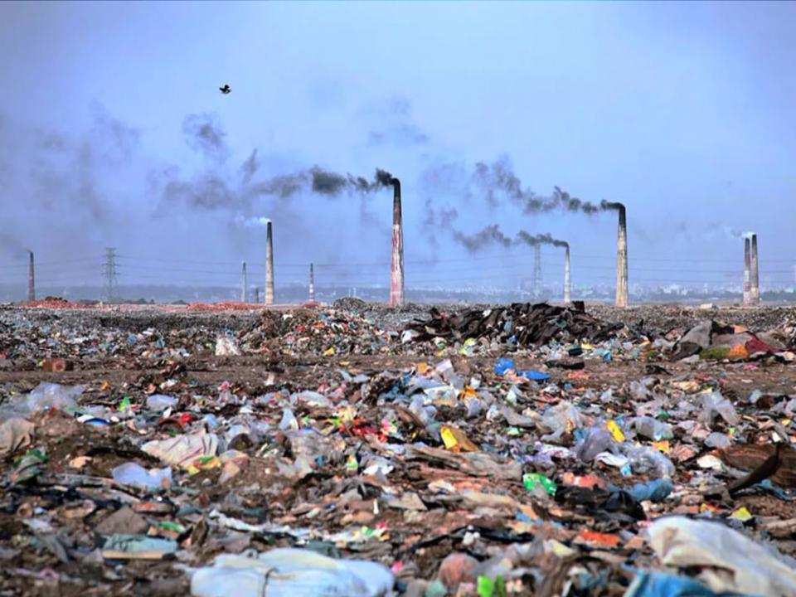
but spoil the environment!

Slide 26
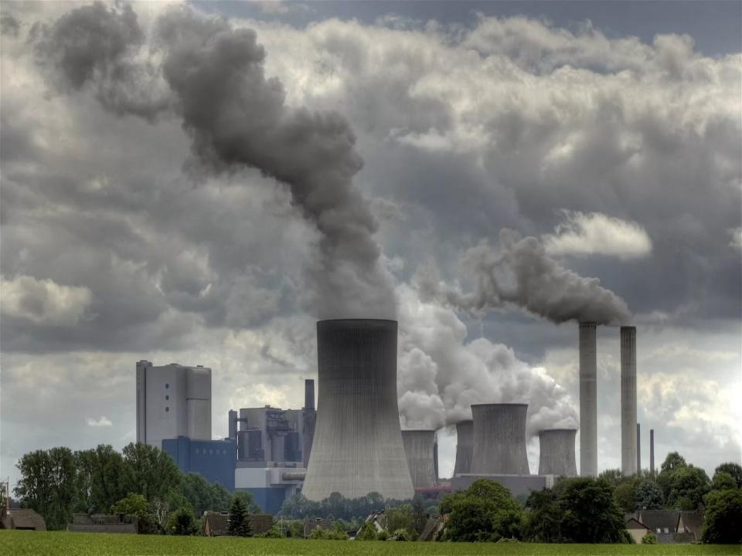
We pollute our air by chemicals.

Slide 27
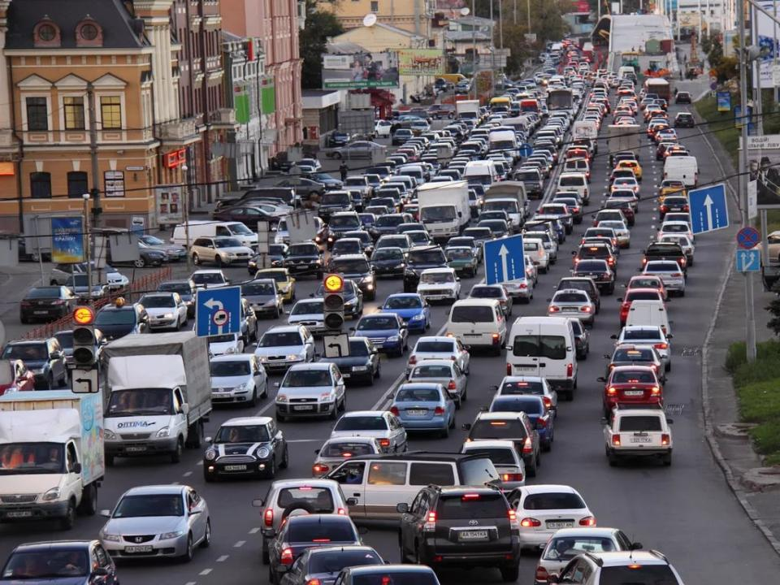
We need more cars, buses and motorbikes.

Slide 28
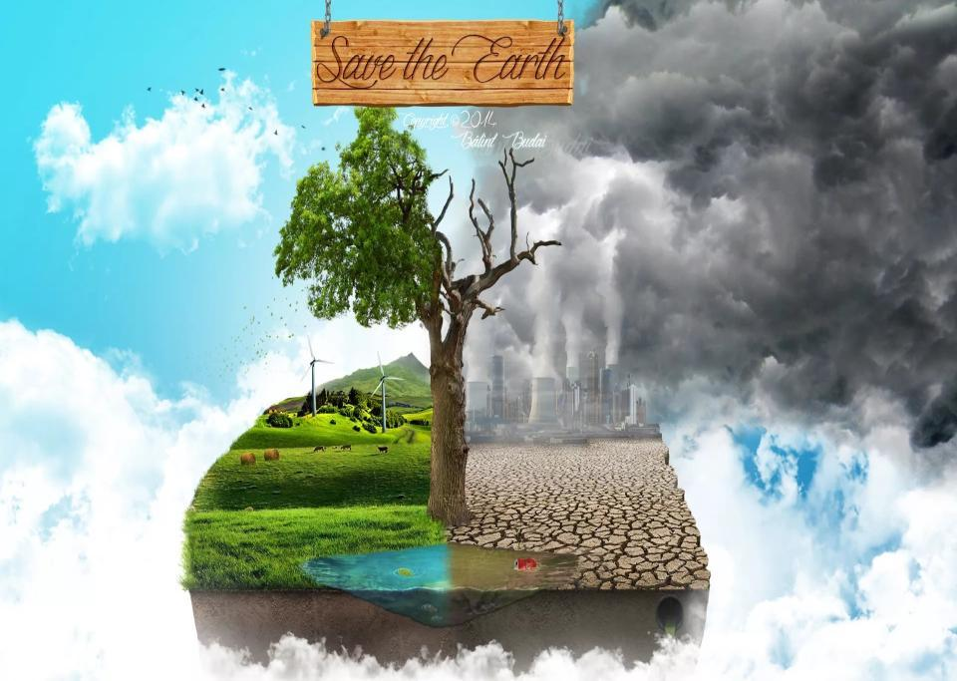
Our nature resources are limited.

Slide 29
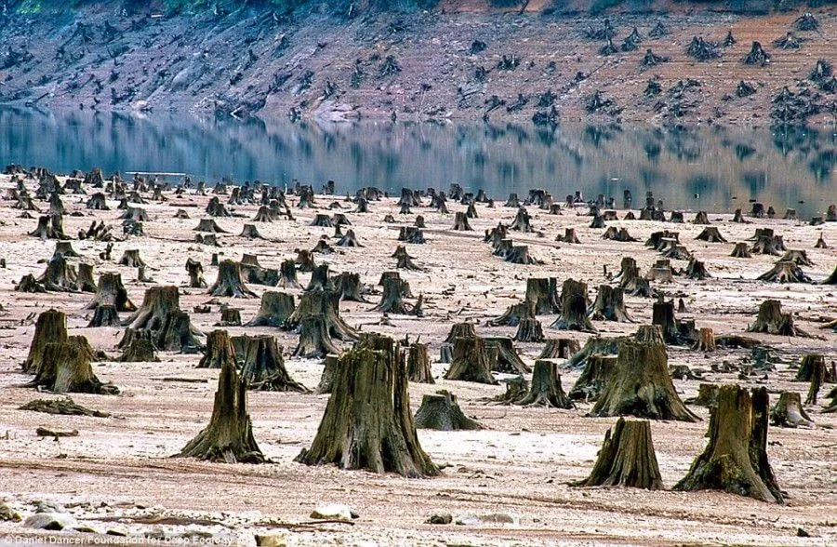
Forests are cut

Slide 30
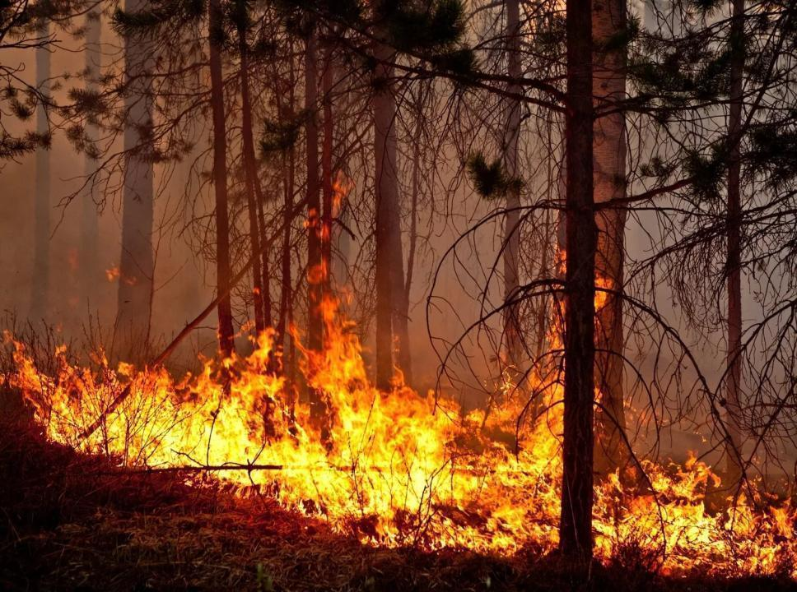
and burn in fire.

Slide 31
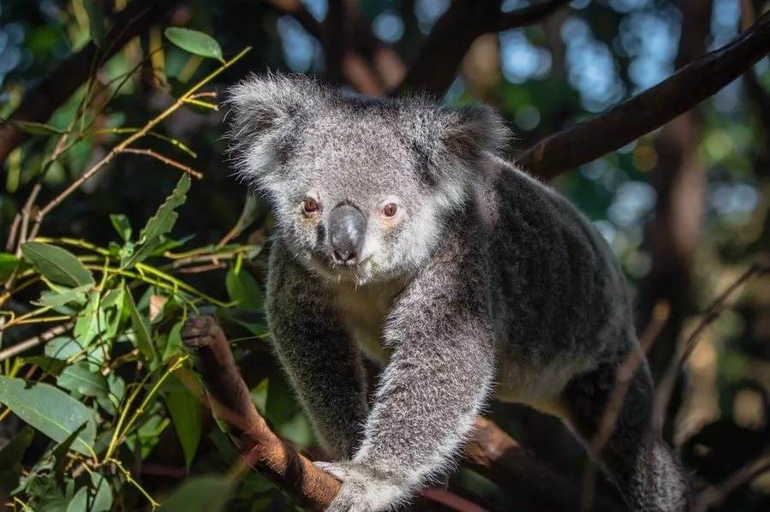
People kill a lot of birds and animals.

Slide 32
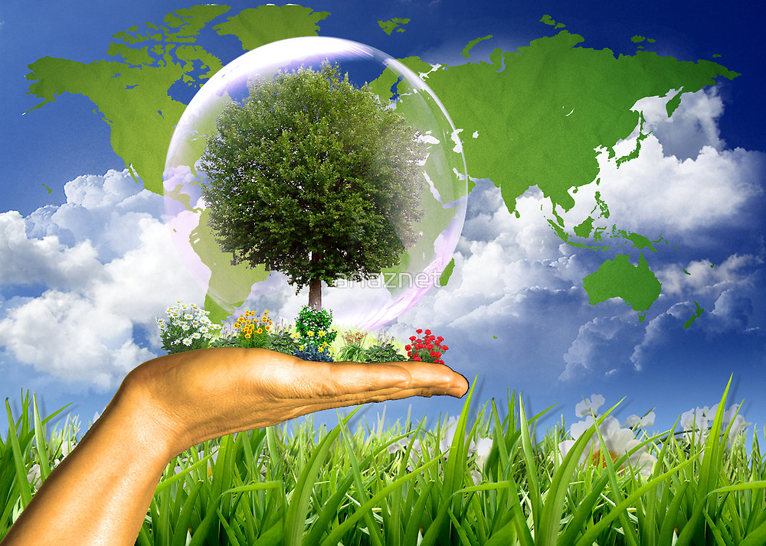
As a result air pollution is not reduced.

Slide 33
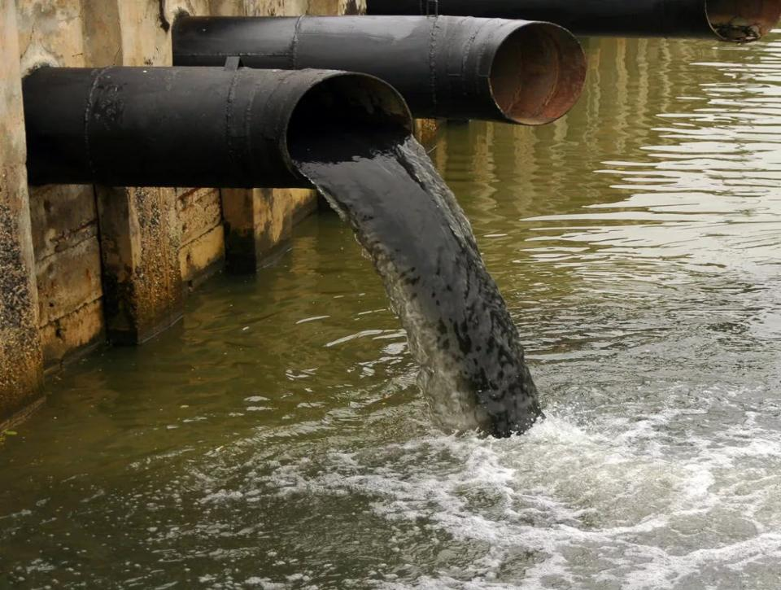
A lot of rivers and lakes are polluted, too.

Slide 34
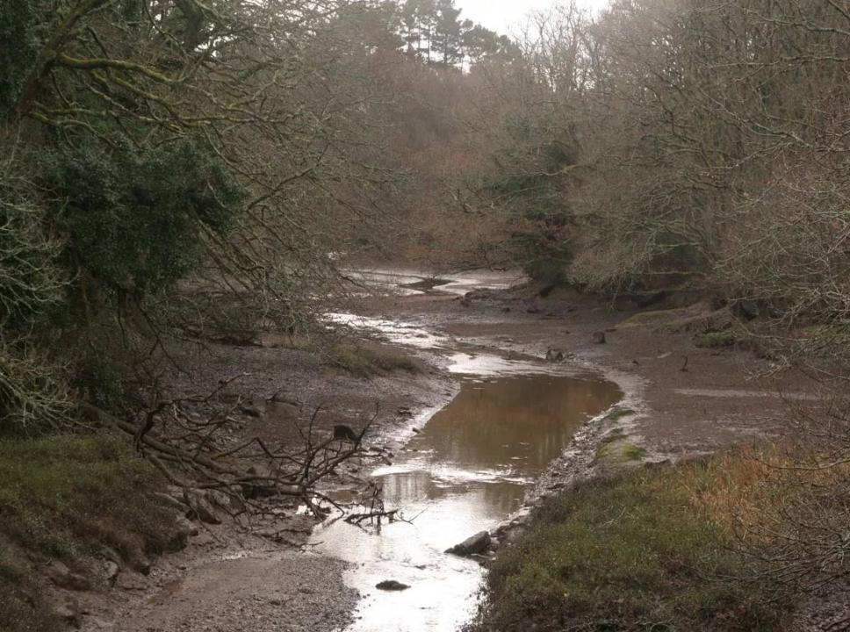
Rivers and lakes dry up.

Slide 35
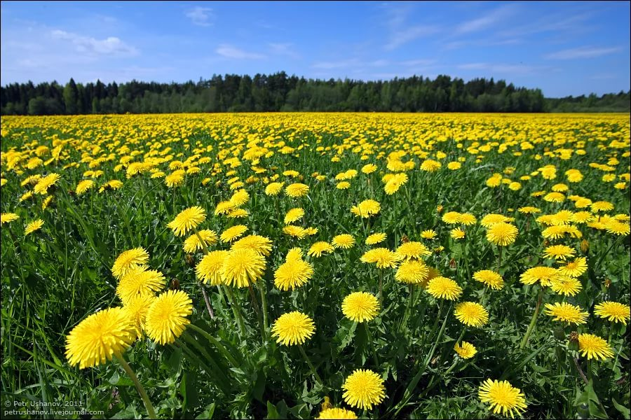
But we try to change our attitude to the environment!

Slide 36
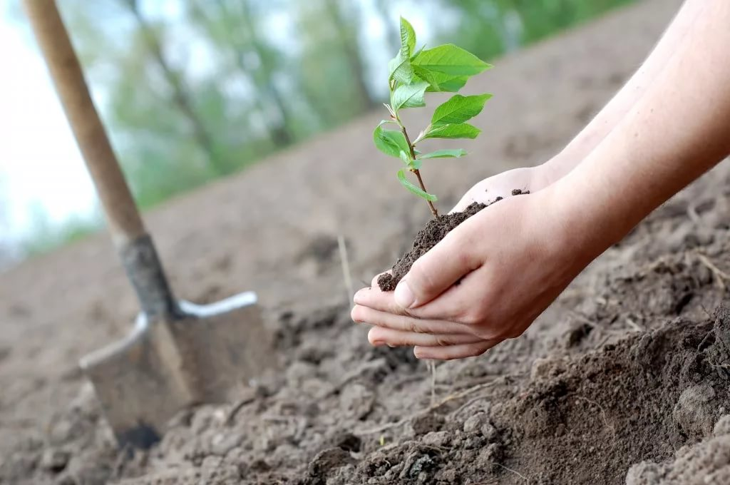
We plant trees,

Slide 37
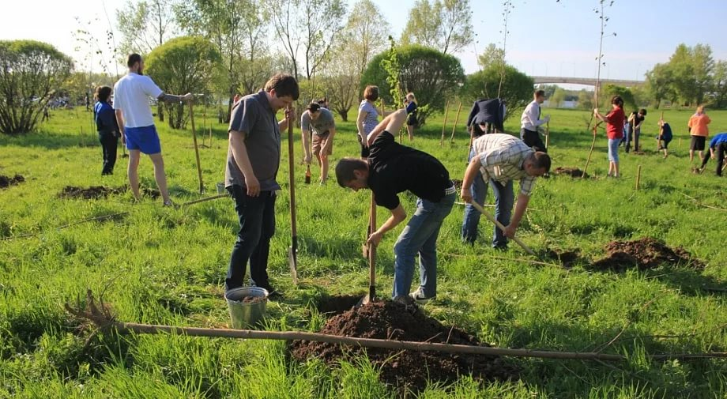
work in the gardens and parks

Slide 38
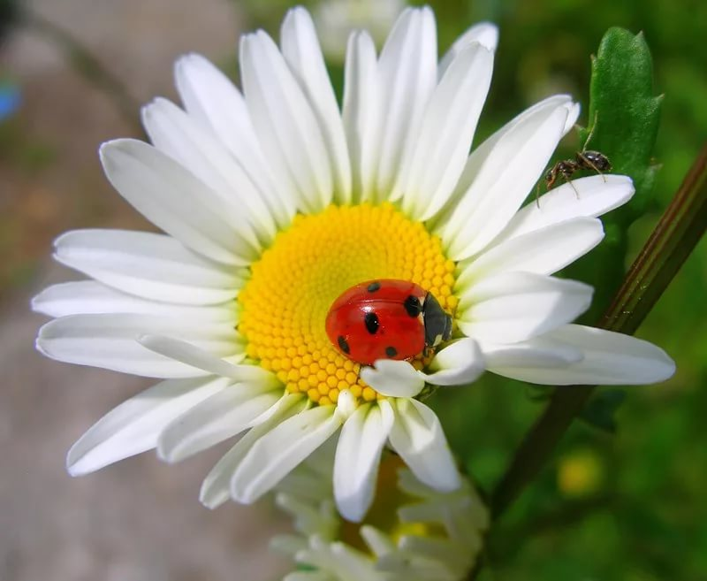
and protect Nature.

Slide 39
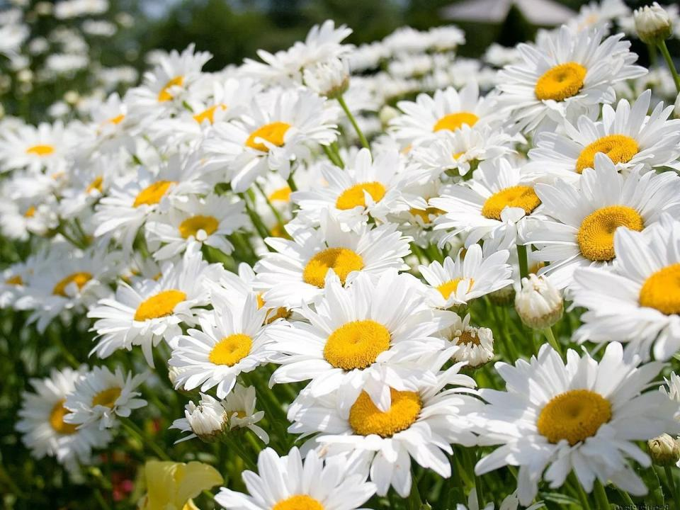
We want to make the world a better place!

Slide 40
Who should be in charge of the planet?

